Slide 1
Personal Analytics tools (Desktop)
WorkTime Personal
ManicTime
Visual Time Analyzer

Slide 2
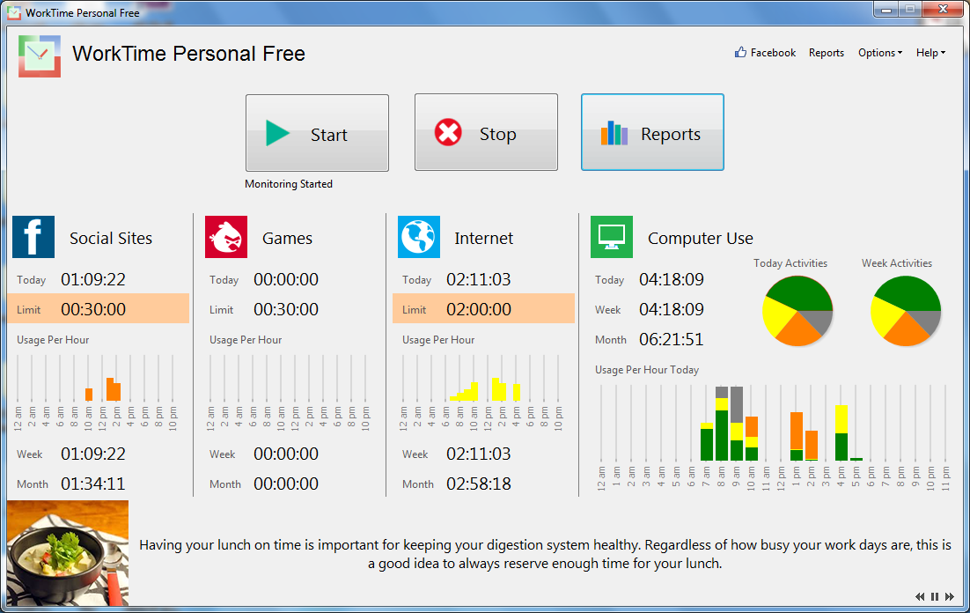
WorkTime Personal

Slide 3
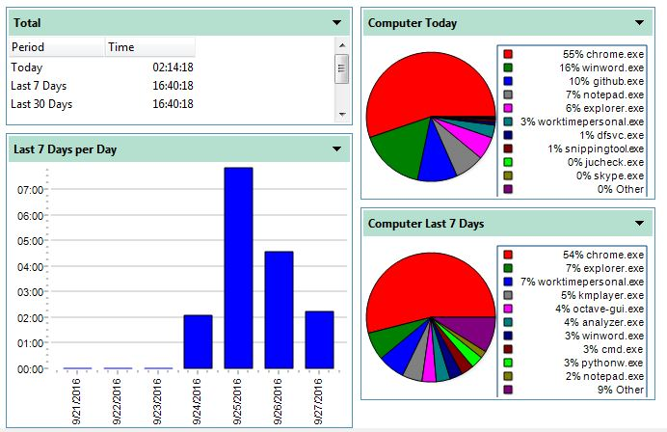
WorkTime Personal – Computer Use

Slide 4
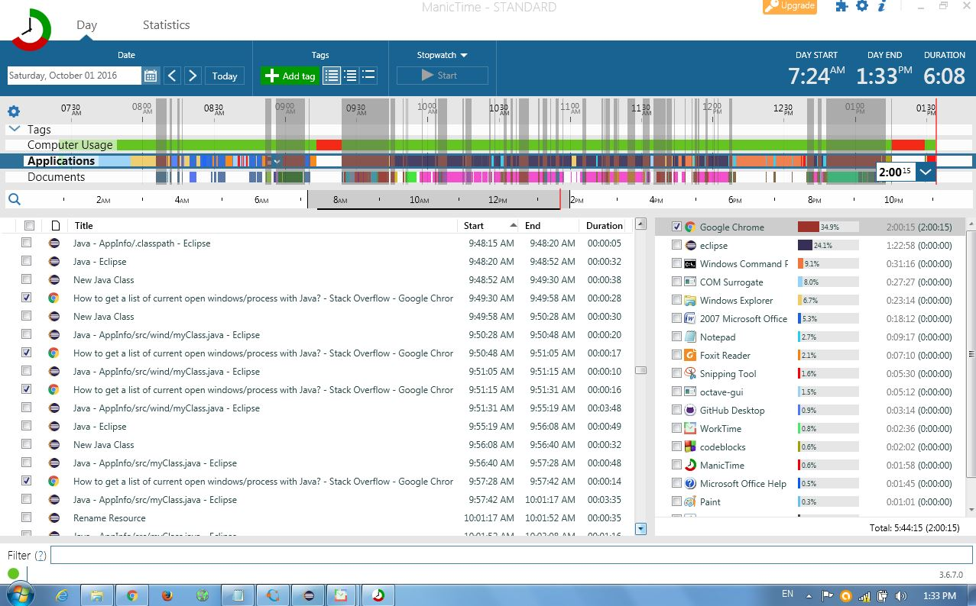
ManicTime

Slide 5
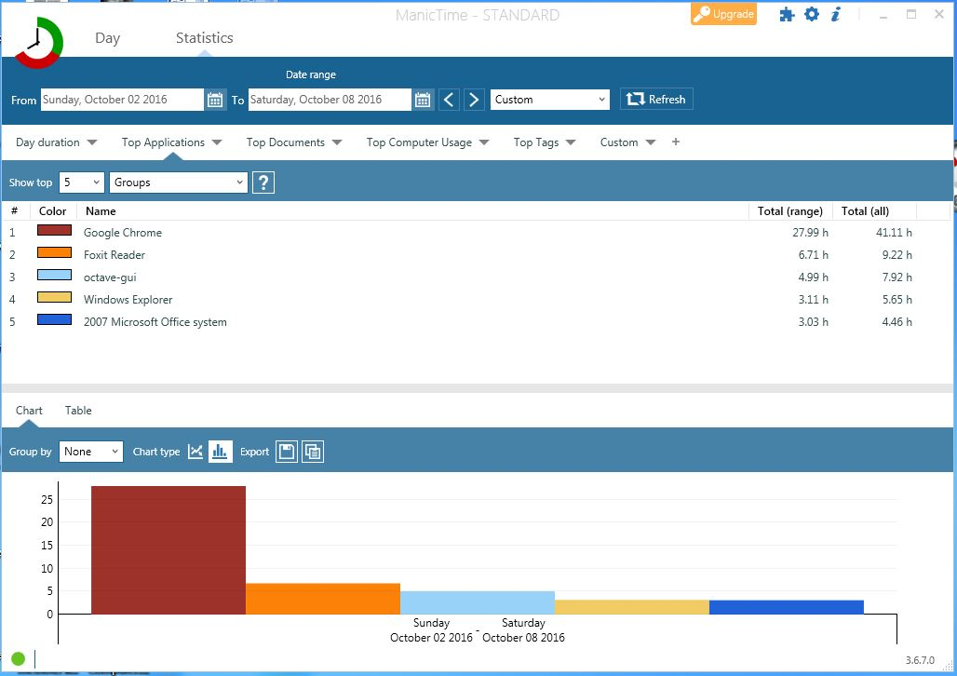
ManicTime – Top Application

Slide 6
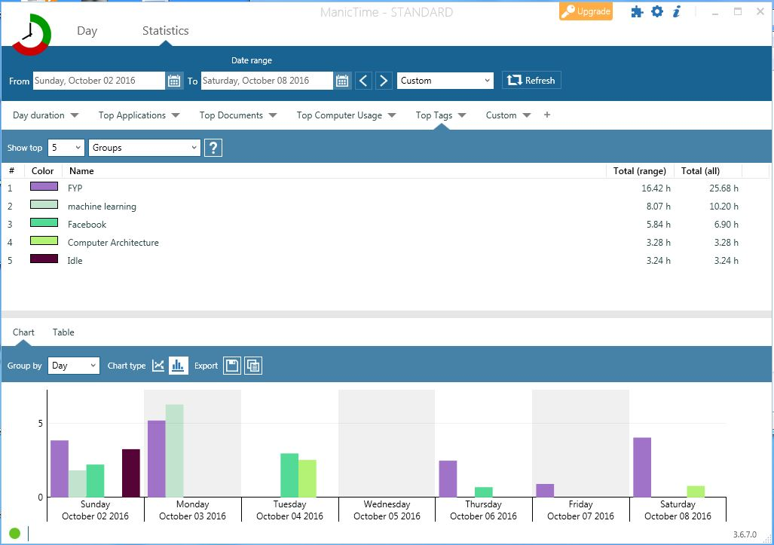
ManicTime – Top Tags

Slide 7
Comparison with our project
Discussed tools
No analysis of data
Only notes Applications and window titles
Our project
Analyze data
Categorize activity nature automatically
“Research” versus “Teaching”

Slide 8
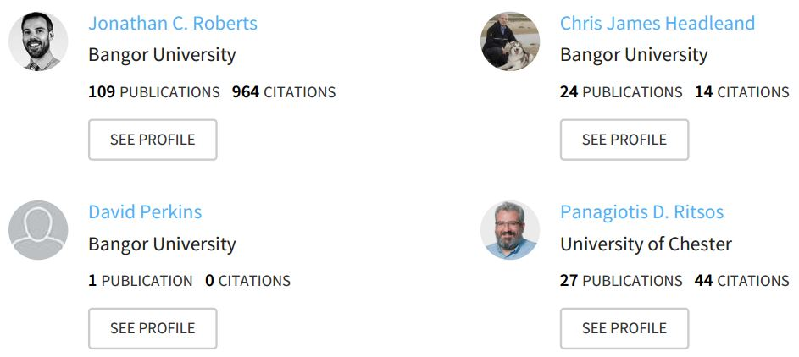
Personal Visualization for Learning
Conference Paper - 2015
4 authors

Slide 9
Personal Visualization for Learning
Problem Statement:
Grade, Weightage, Attendance etc
Data on personal learning is lacking
Solution:
Personal Data → Personal Visualization → Personal Learning
Dynamically and regularly updated personal data

Slide 10
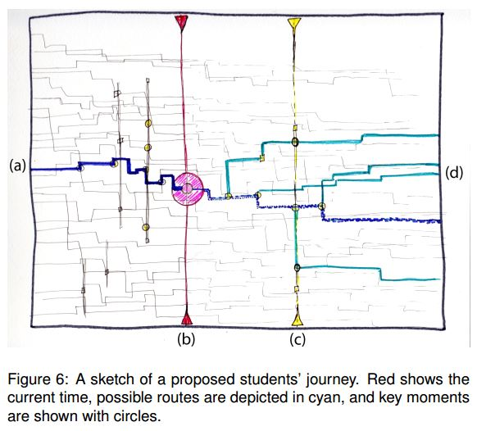
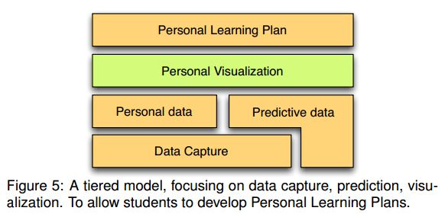
Personal Visualization for Learning
Assumptions:
Proposed tiered approach
Most data captured
Some data predicted

Slide 11
Personal Visualization for Learning
Challenges:
Intrusion into personal life
Security and anonymization priority

Slide 12
A Stage-Based Model of Personal Informatics Systems
5 stages
4 properties
Design guidelines
Ian Li Anind Dey Jodi Forlizzi HCII, Carnegie Mellon University

Slide 13
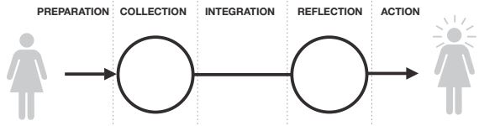
Model of Personal Informatics
1. Barriers cascade.
2. Stages are iterative. Design
3. User- vs. System-driven guidelines
4. Facets

Slide 14
Contribution
Barriers and Model
Identified a list of problems
Defined a model of personal informatics
Design Guidelines
Described 4 properties with implications for
design of personal informatics systems

Slide 15
References
http://www.worktime.com/personal/
http://www.manictime.com/
http://www.neuber.com/timeanalyzer/index.html
https://www.researchgate.net/publication/281812644
http://www.academia.edu/download/30734346/p557.pdf

